Slide 1
“Big data” and science bottlenecks
Lauren Hallett

Slide 2
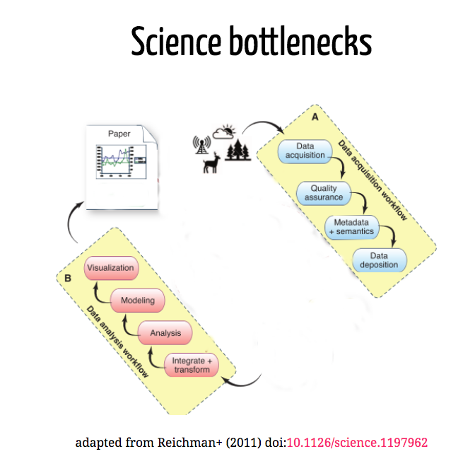

Slide 3
Our focus is on these Science bottlenecks

Slide 4

Course content: Developing workflows for the data life cycle
Wickham and Grolemund R for Data Science

Slide 5
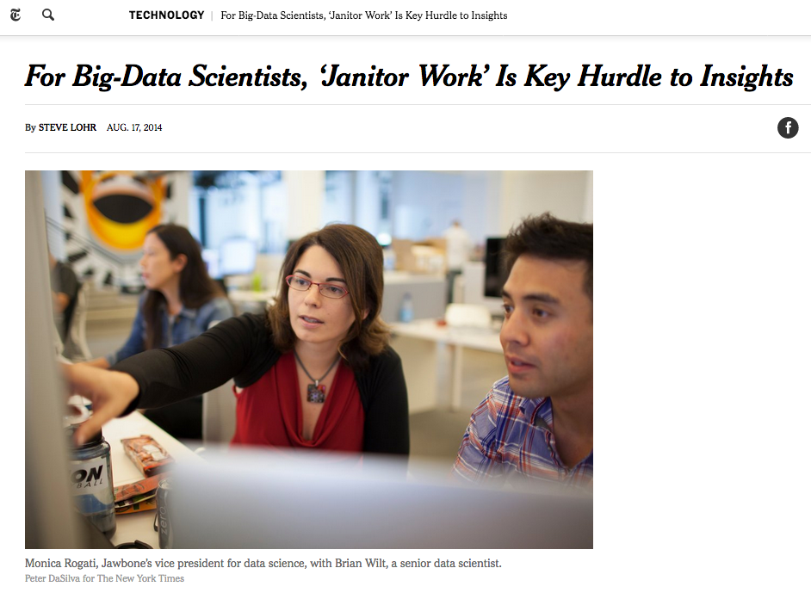
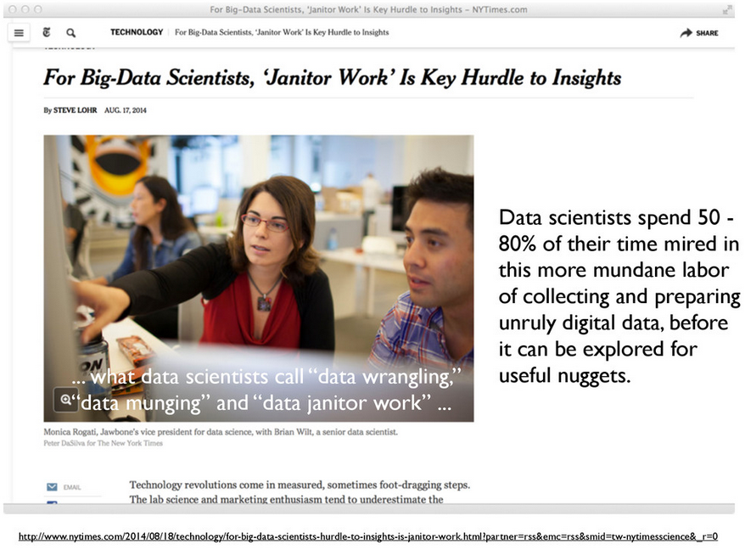
Data cleaning

Slide 6
Analysis and modeling
Formally the 80%
Computational developments have made this much easier
And led to an explosion in new methods and tools

Slide 7
Different ways for data to be “big”
Volume
Variety
Velocity

Slide 8
Volume

Slide 9
Data visualization
Today the visualization component has become a bottleneck
To often visualization becomes only an end-product rather than an exploration tool
A problem because visualization is a quick way to spot errors
Fox & Hendler (2001): doi:10.1126/science.1197654

Slide 10
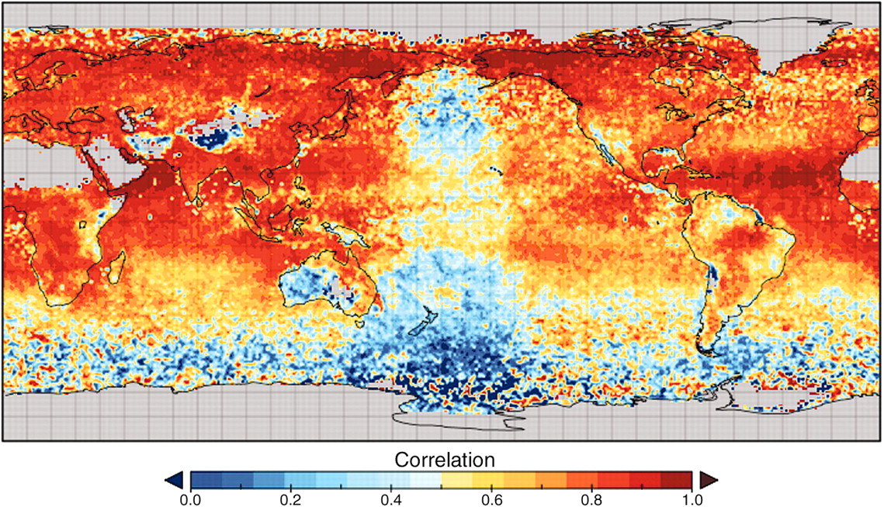
Fox & Hendler (2001): doi:10.1126/science.1197654

Slide 11
Variety

Slide 12
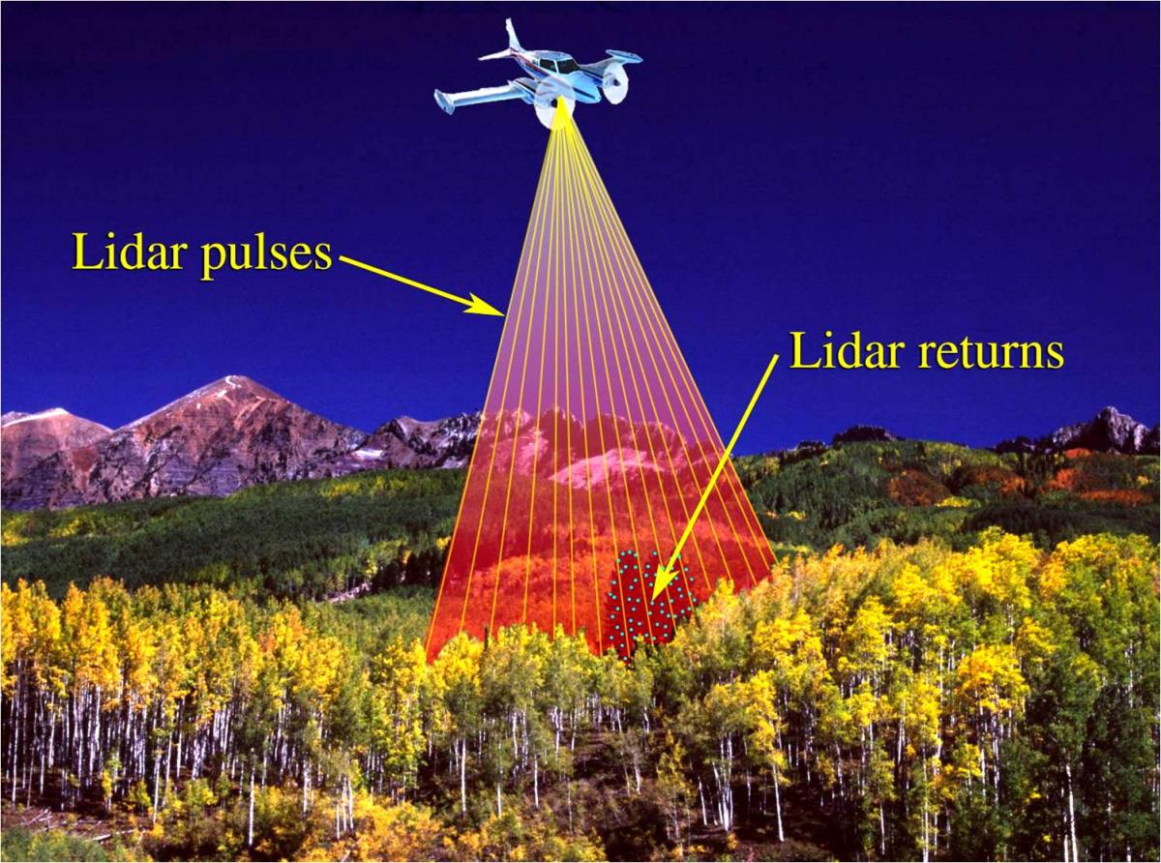

Slide 13
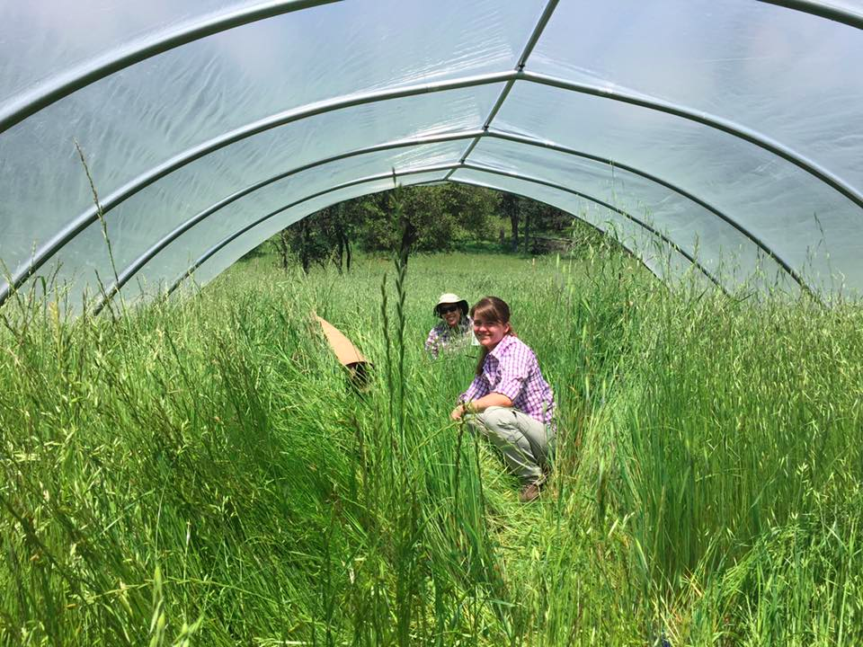

Slide 14

Vertically integrated data repositories

Slide 15

Limits to vertical integration

Slide 16
Velocity

Slide 17
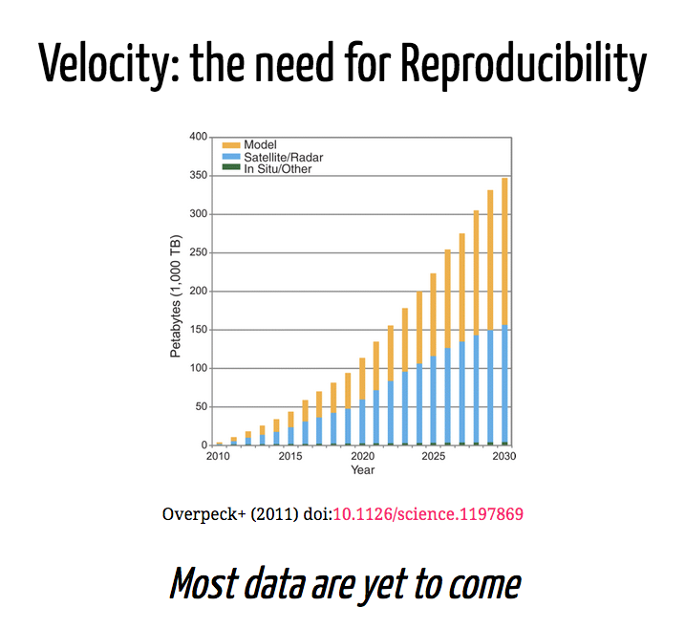

Slide 18
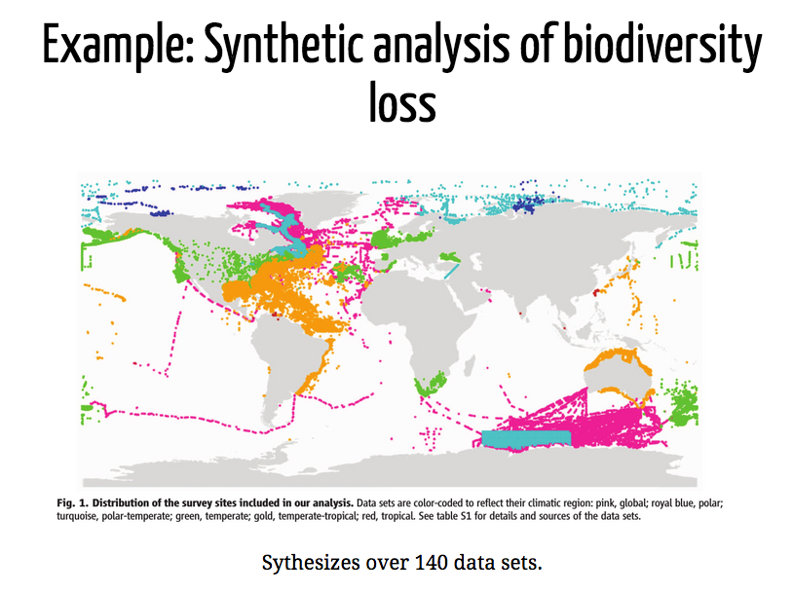

Slide 19
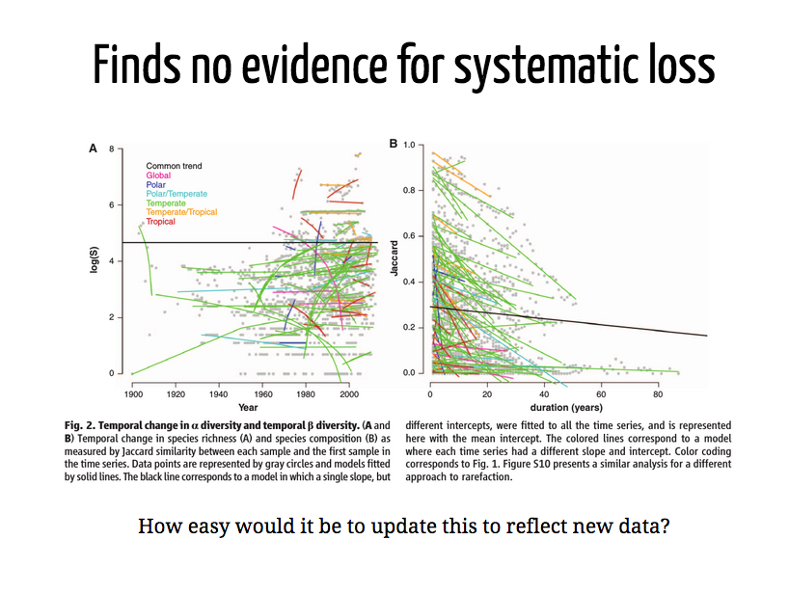

Slide 20
Reproducibility: Important for other reasons as well

Slide 21
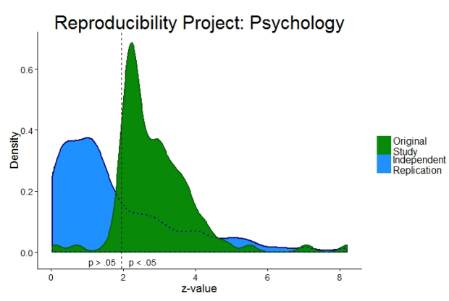

Slide 22
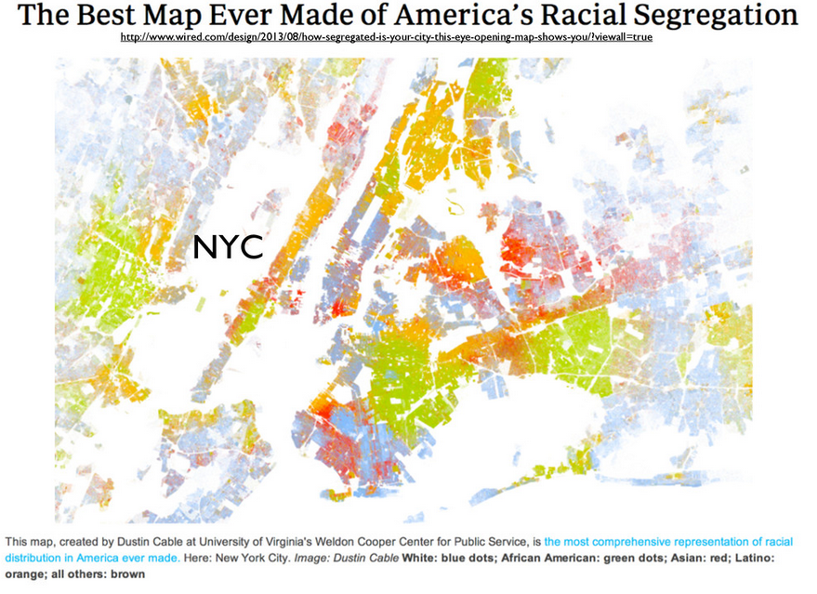

Slide 23
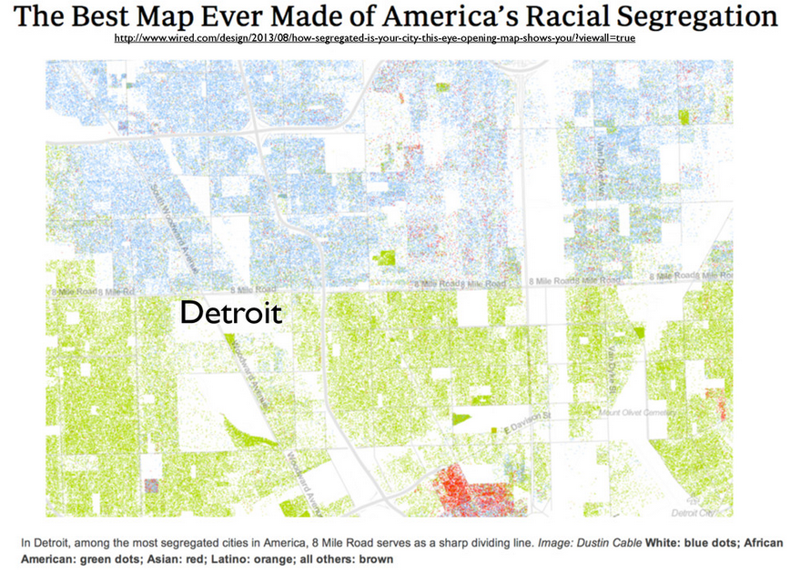

Slide 24
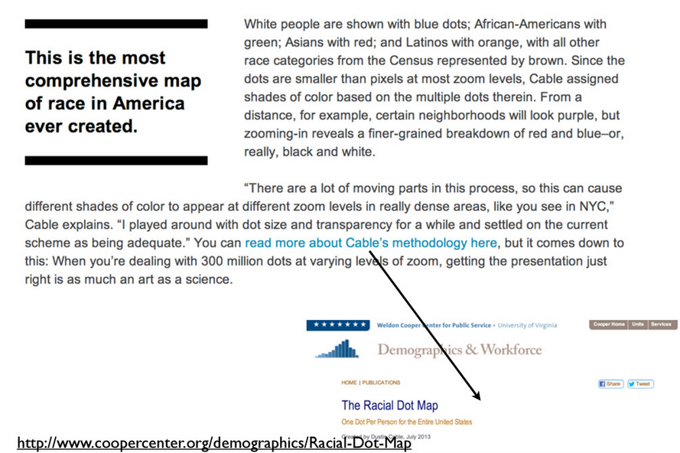

Slide 25
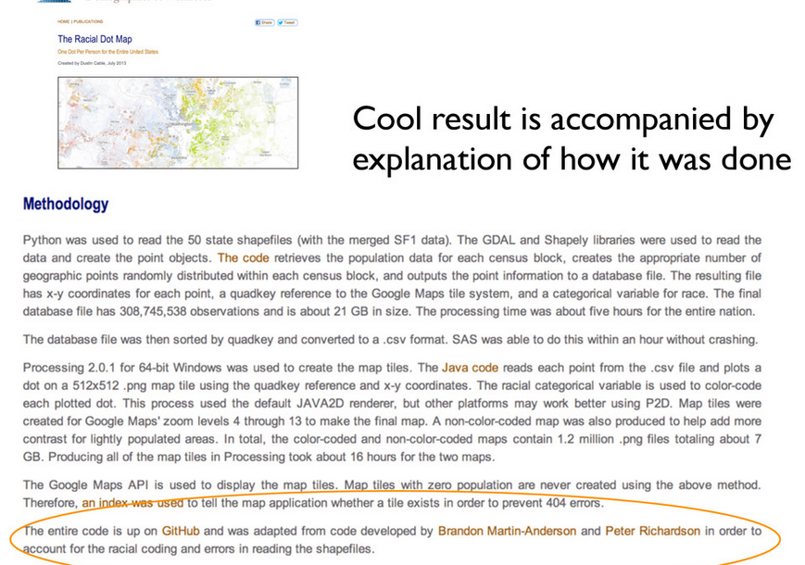

Slide 26
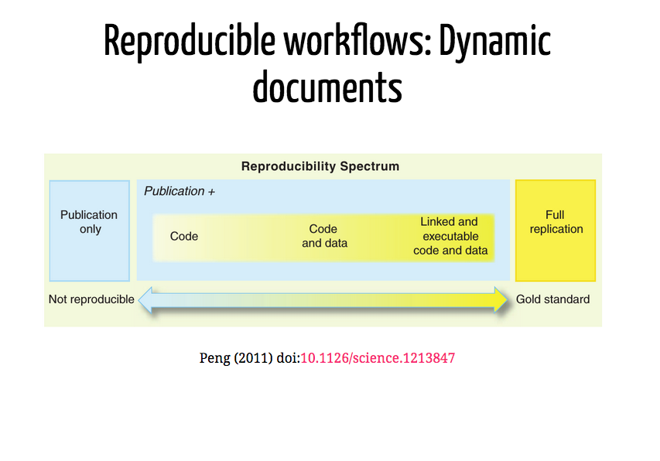

Slide 27
Exploratory data analysis exercise
Goals for this exercise:
Highlight the value of plotting our data before we analyze it
Get to know one another
Viscerally appreciate how much easier R will make our lives!

